Slide 1
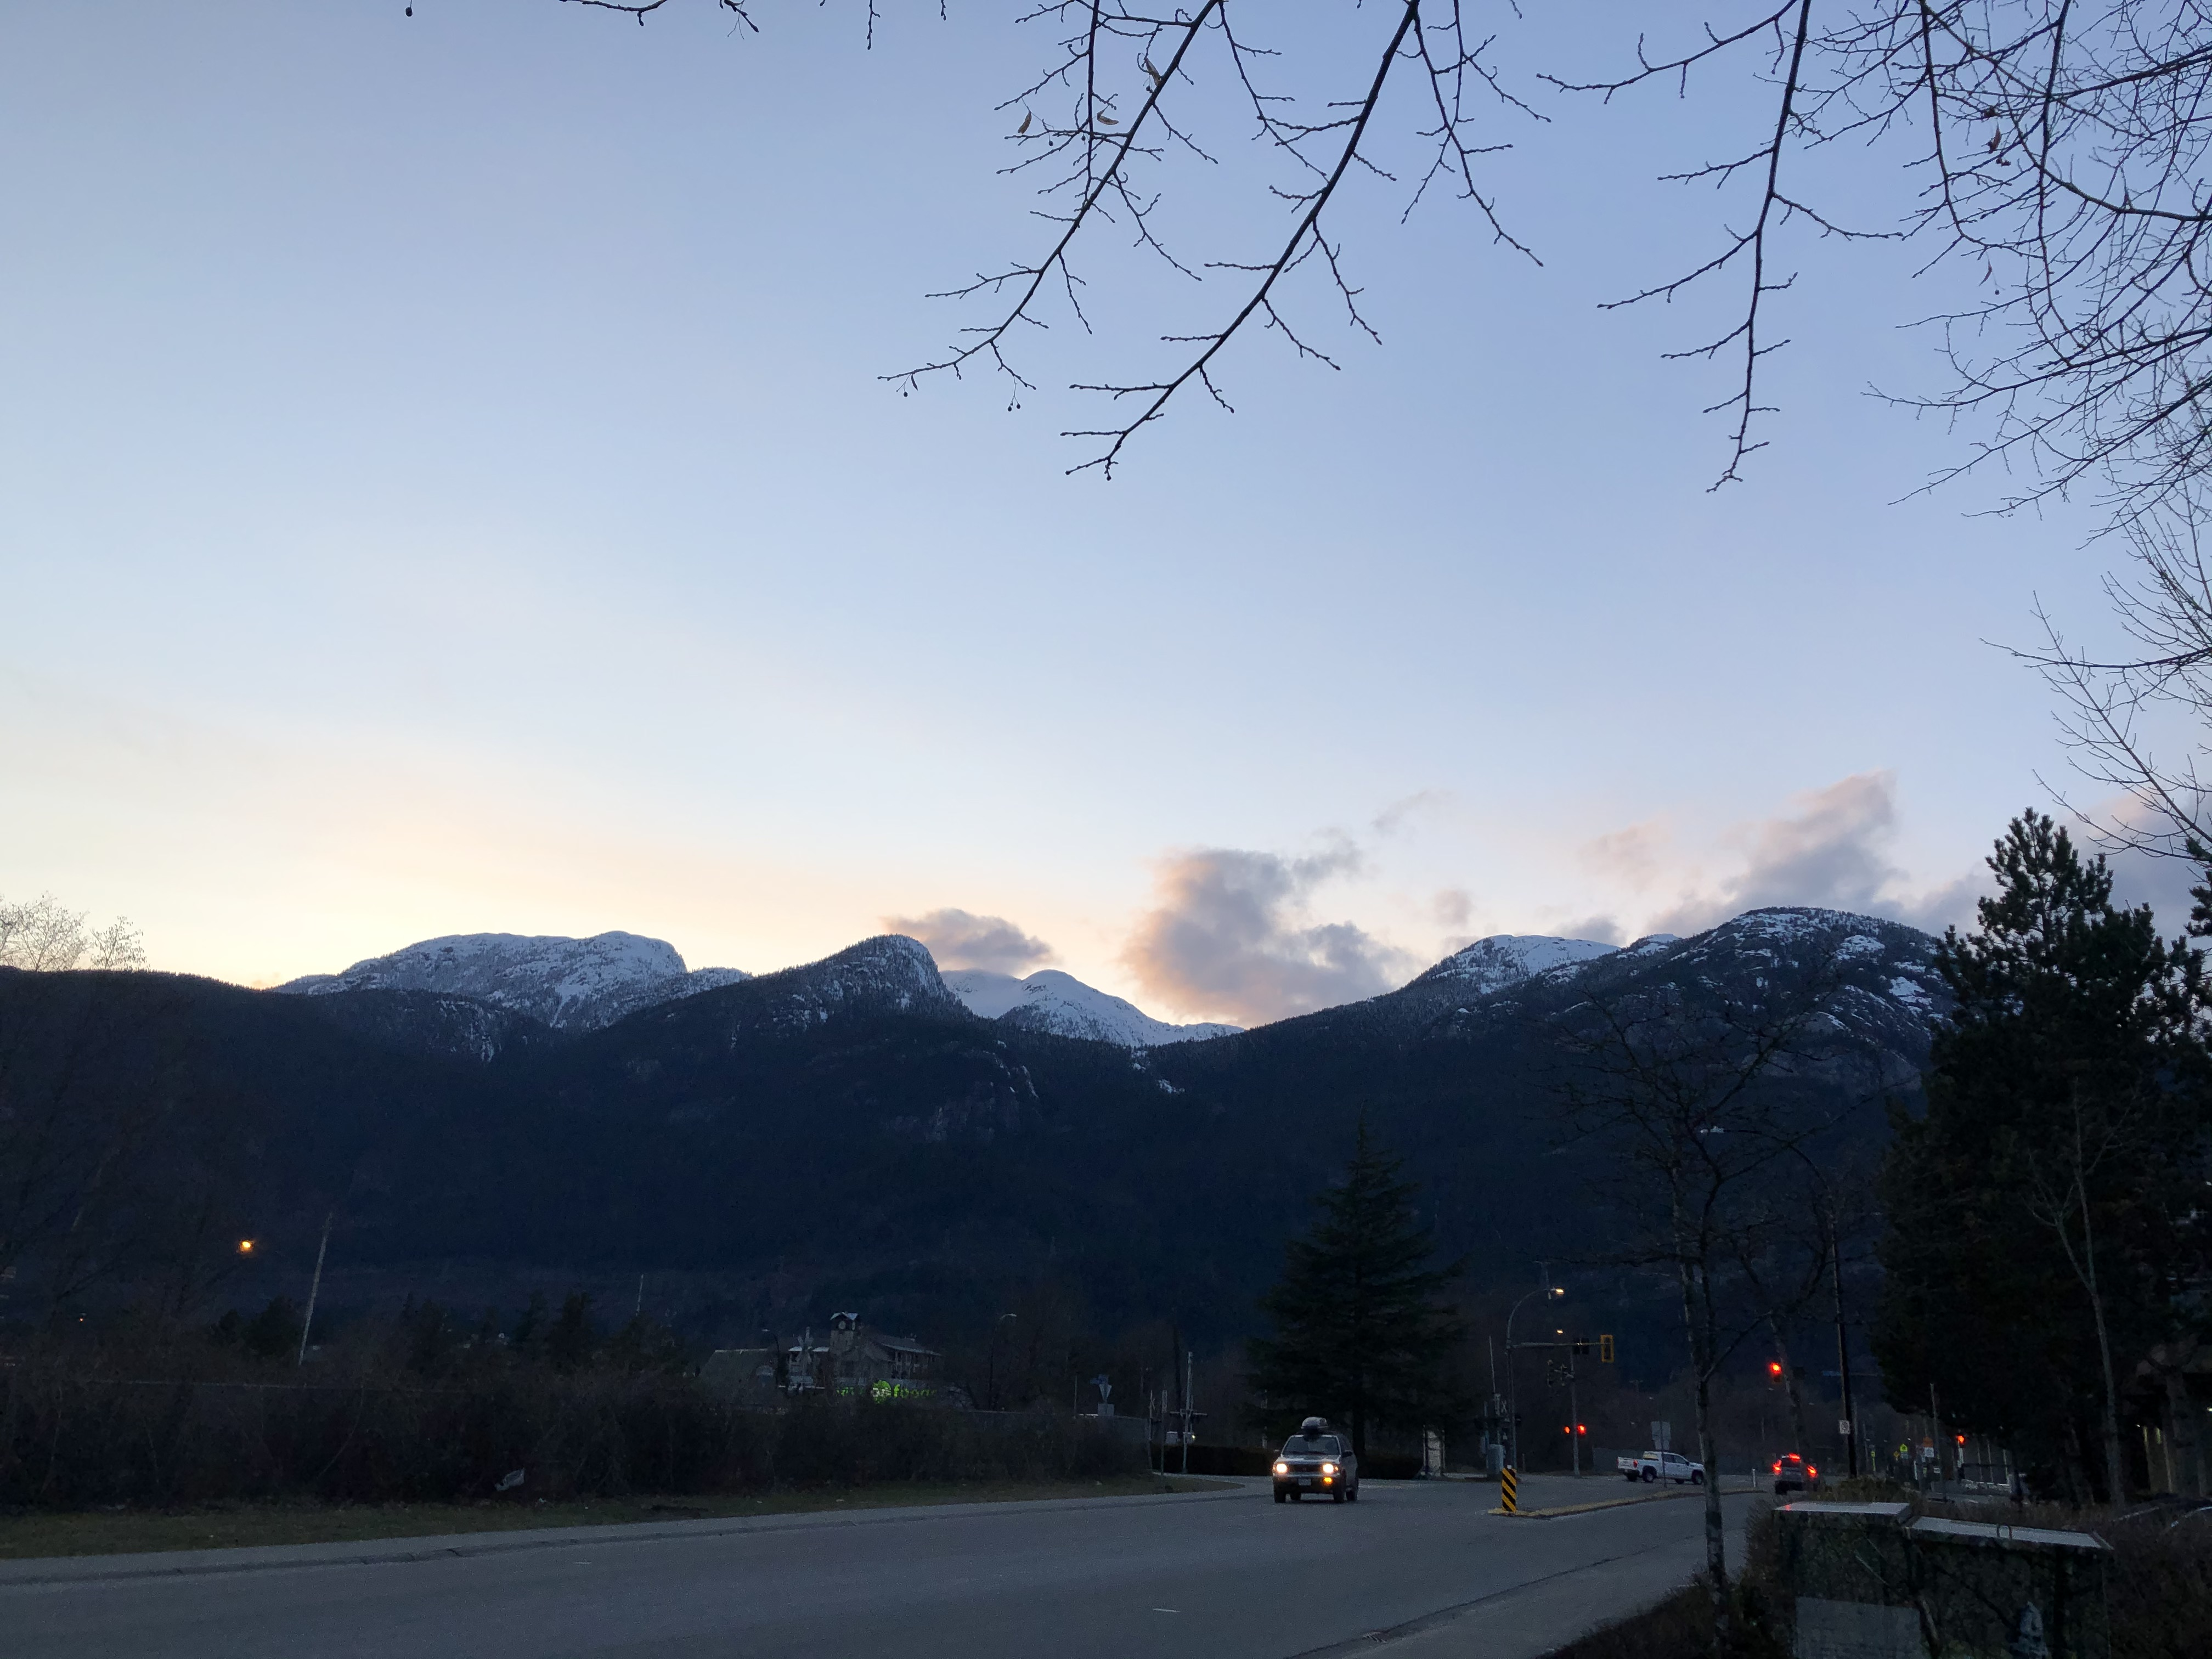
To Bus or not To Bus
By Fynn Davis

Slide 2
Should I take the bus or car between two points?
Air quality
Trip duration
Disruption
AirQuality
Journey
isDisruption
Congestion
Transport
Traffic
Crowding
Roads
Is it worth taking this mode of public transport?

Slide 3
AirQuality
TFL_API
air_quality
start
stop
Journey/JourneyResults
route_disrupted
start
recommend_transport
journey_status
fastest_route
stop
TFL_API
Take
Don’t take
depart_station
crowding/{station}/Live
crowding_results
crowd_percent

Slide 4
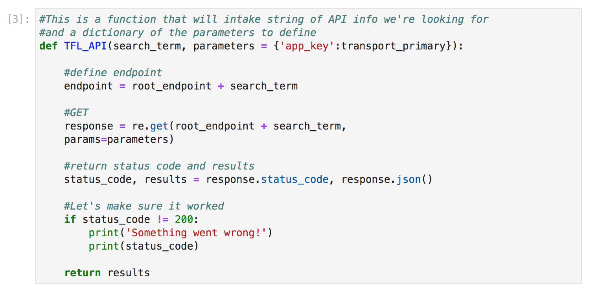
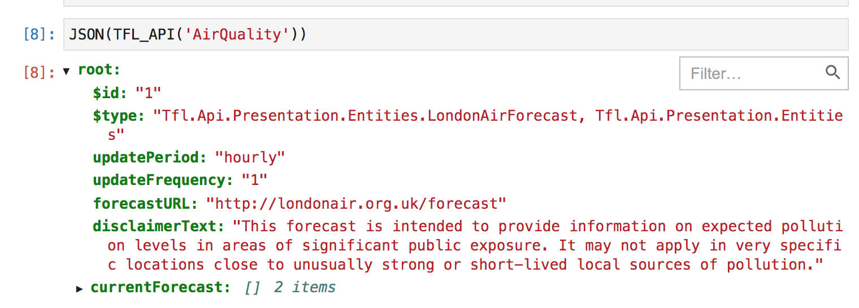
Code snippet (API function)

Slide 5
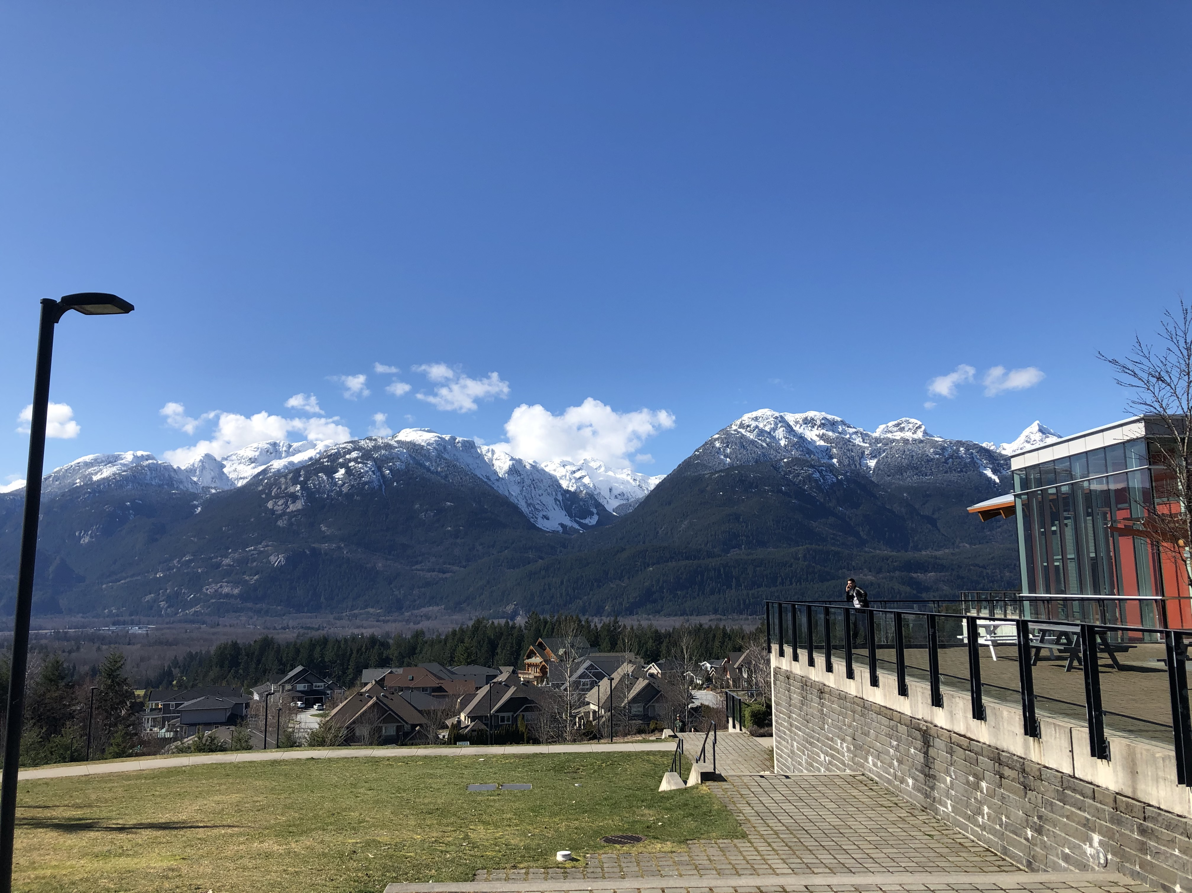
Questions?

